Slide 1
Membrane Air Separation
Group 4
Rishabh S. Patel, Kyle Hankosky, Khoa Nguyen, Alexis Guillen
Chemical Engineering Lab V
11/11/25

Slide 2
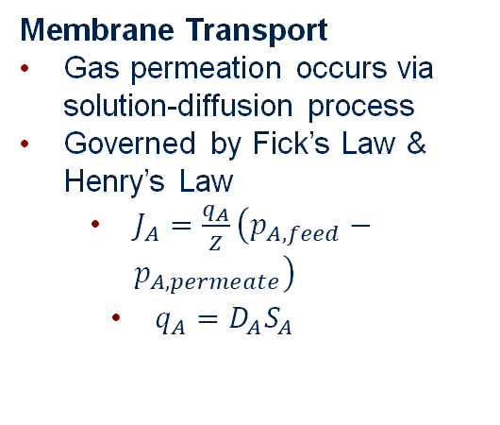
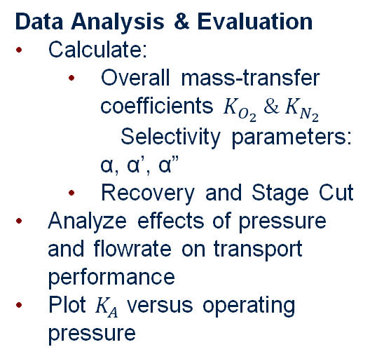
Introduction
The main purpose of this lab is to study gas separation using nonporous polymeric membranes & evaluate how the differences in diffusivity & solubility affect gas transport through this membrane
Membrane Transport
Gas permeation occurs via solution-diffusion process
Governed by Fick’s Law & Henry’s Law
$J_{A}=\frac{q_{A}}{Z}\left(p_{A,feed}−p_{A,permeate}\right)$
$q_{A}=D_{A}S_{A}$
Apparatus & Experimental Setup
Two Prism™ membrane modules containing polysulphone hollow fibres (~2.7m^2 per module)
Can be operated in series or parallel to compare separation efficiency
Compressed air flows through fibre lumens and oxygen-enriched gas permeates into shell side
Data Analysis & Evaluation
Calculate:
Overall mass-transfer coefficients $K_{O_{2}} \& K_{N_{2}}$ Selectivity parameters: α, α’, α”
Recovery and Stage Cut
Analyze effects of pressure and flowrate on transport performance
Plot $K_{A}$ versus operating pressure

Slide 3
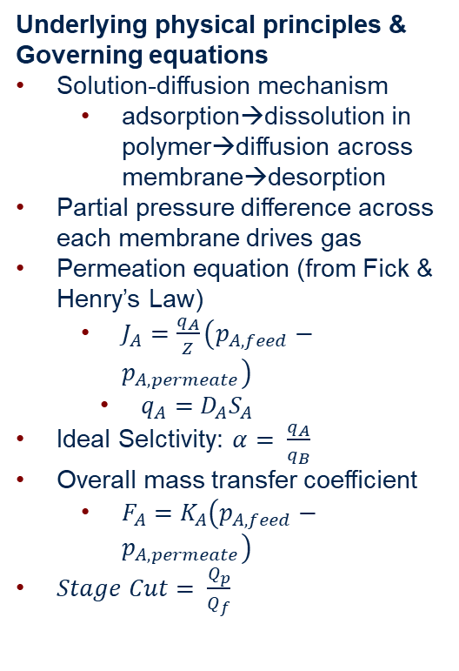
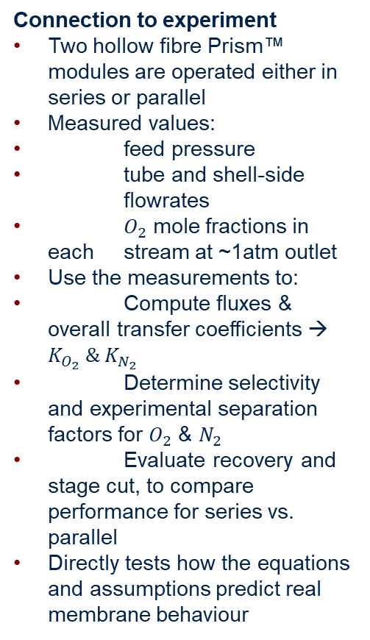
Theory
Underlying physical principles & Governing equations
Solution-diffusion mechanism
adsorption→dissolution in polymer→diffusion across membrane→desorption
Partial pressure difference across each membrane drives gas
Permeation equation (from Fick & Henry’s Law)
$J_{A}=\frac{q_{A}}{Z}\left(p_{A,feed}−p_{A,permeate}\right)$
$q_{A}=D_{A}S_{A}$
Ideal Selctivity: $α= \frac{q_{A}}{q_{B}}$
Overall mass transfer coefficient
$F_{A}=K_{A}\left(p_{A,feed}−p_{A,permeate}\right)$
$Stage Cut= \frac{Q_{p}}{Q_{f}}$
Assumptions & Limitations
Membranes are treated as nonporous, dense and uniform→const. thickness, Z
Steady-State: transient behaviour neglected
Isothermal conditions
Gas phase is ideal
Negligible external mass-transfer resistance
Negligible pressure drop
System treated mainly as a binary mixture
Permeation described only by solution-diffusion
Connection to experiment
Two hollow fibre Prism™ modules are operated either in series or parallel
Measured values:
feed pressure
tube and shell-side flowrates
$O_{2}$ mole fractions in each stream at ~1atm outlet
Use the measurements to:
Compute fluxes & overall transfer coefficients → $K_{O_{2}} \& K_{N_{2}}$
Determine selectivity and experimental separation factors for $O_{2}$ & $N_{2}$
Evaluate recovery and stage cut, to compare performance for series vs. parallel
Directly tests how the equations and assumptions predict real membrane behaviour

Slide 4

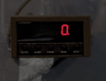






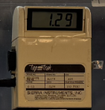
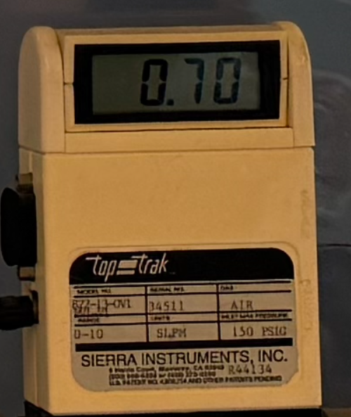
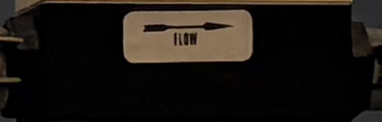
Apparatus
Membrane Separator Modules | Strain-gauge Transducer | 3-Way Directional Valves
Manifold | Oxygen Analyzers | Volumetric flowmeters

Slide 5
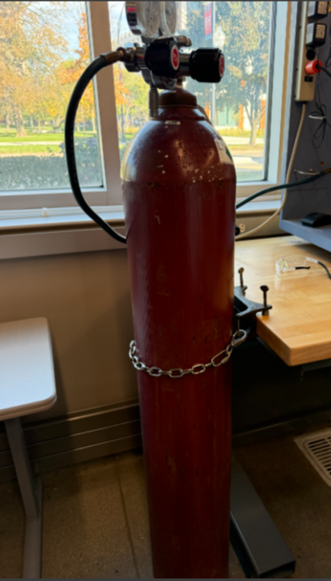
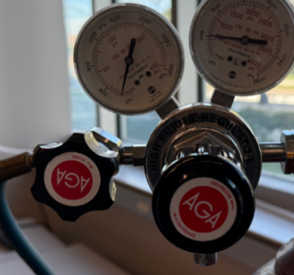
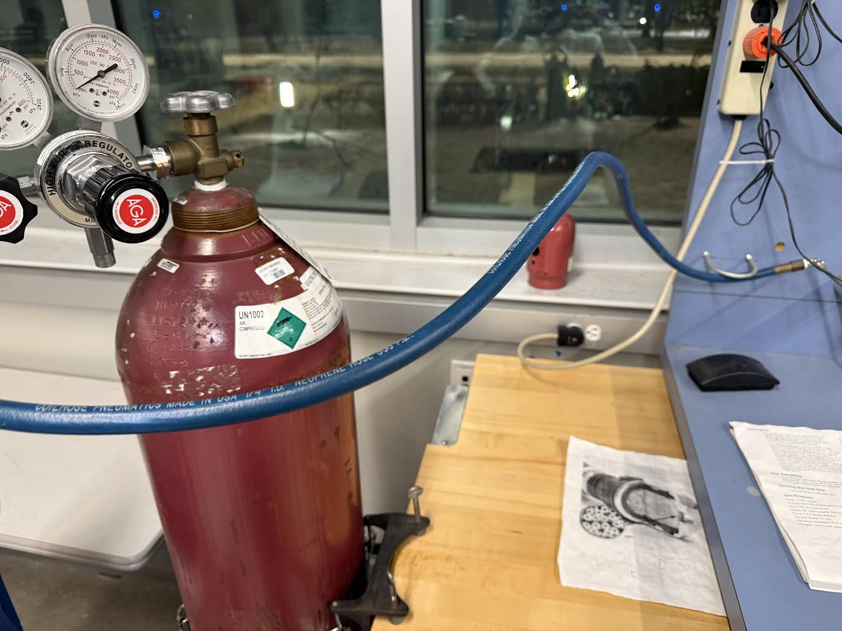
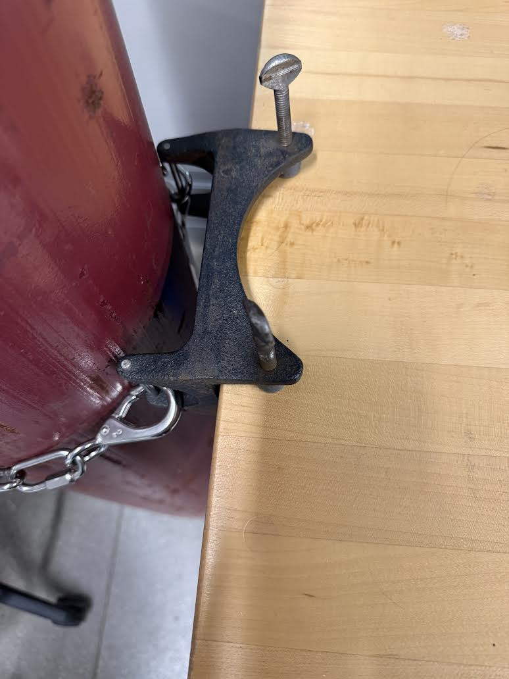
Material & Supplies
Compressed Air Cylinder | Two-stage Pressure Regulator
Hose
Clamp

Slide 6
Procedure
Preparation
Turn on and calibrate both oxygen analyzers
Plug in the mass flow meters & pressure transducer
Open the high-pressure air cylinder valve and record cylinder pressure (>2000 psig)
Adjust the regulator to desired feed pressure (30-40 psig, for the initial run)
2. Setup Configuration
For Parallel:
Valve A, left
Valve B, up
Valve C, down
Valve D, up
For Series:
Valve A, right
Valve B, up
Valve C, up
Valve D, up
3. Operation
Set desired tube-side flowrate using needle valve
Allow readings to stabilize
Record:
Operating pressure
Tube and Shell side flowrates
O2 conc. for each module
Ambient temp.
4. Data Collection
Perform atleast 15 runs across different pressures
And flowrates
Repeat for both configurations

Slide 7
Experimental Challenges
Difficulties
Maintaining steady pressure while adjusting needle valve
Recalibrating Oxygen analyzer to ensure accurate readings
Small leaks/valve misalignment which impacted flowrates
Things to watch
Do not leave valves in middle position – causes pressure buildup
Allow analyzers to run for a while before recording data – let readings settle
Ensure each valve position before a run
Recheck flow and pressure after an adjustment
Lessons Learned
Letting readings stabilize before recording can ensure more accurate/consistent data

Slide 8
Safety
Pressurized gas cylinder – Ensure it stays secured in position, open the valve slowly to prevent pressure shock
Valves – Do not leave valves in middle position, otherwise this can trap pressure and rupture fittings
Leaks – Check fittings for leaks before pressurizing the system

